Slide 1
Loaders and Linkers
Module-4

Slide 2
Loader Schemes
1.Compile and Go Loaders
2. General Loader Scheme
3. Absolute Loaders
4. Subroutine Linkages
5. Relocating Loaders
6. Direct Linking Loaders
7. Other Loader Schemes:
a) Dynamic Loading
b) Dynamic Linking

Slide 3
Content
Subroutine Linkage
Relocating Loader

Slide 4
Subroutine Linkage
It deals with the special mechanism for calling another subroutine in an assembly language program.

Slide 5
Subroutine Linkage
It deals with the special mechanism for calling another subroutine in an assembly language program.
The problem of subroutine linkage is this: a main program
  A wishes to transfer to subprogram B.

Slide 6
Subroutine Linkage
It deals with the special mechanism for calling another subroutine in an assembly language program.
The problem of subroutine linkage is this: a main program
  A wishes to transfer to subprogram B.
  The programmer, in program A, could write a transfer instruction (e.g., BAL 14, B) (Branch and Link) to subprogram B.

Slide 7
Subroutine Linkage
It deals with the special mechanism for calling another subroutine in an assembly language program.
The problem of subroutine linkage is this: a main program
  A wishes to transfer to subprogram B.
  The programmer, in program A, could write a transfer instruction (e.g., BAL 14, B) (Branch and Link) to subprogram B.
  However, the assembler does not know the value of this Symbol reference and will declare it as an error (undefined Symbol) unless a special mechanism has been provided.

Slide 8
Subroutine Linkage
There are two assembler pseudo-ops which are used for subroutine linkages :
  EXTRN: It is followed by a list of Symbols which indicates that these Symbols are defined in other programs but referenced in the present program.

Slide 9
Subroutine Linkage
There are two assembler pseudo-ops which are used for subroutine linkages :
  EXTRN: It is followed by a list of Symbols which indicates that these Symbols are defined in other programs but referenced in the present program.
  ENTRY: It is followed by a list of Symbols which indicates that these Symbols are defined in same programs but referenced in the other program.

Slide 10
Subroutine Linkage
There are two assembler pseudo-ops which are used for subroutine linkages :
  EXTRN: It is followed by a list of Symbols which indicates that these Symbols are defined in other programs but referenced in the present program.
  ENTRY: It is followed by a list of Symbols which indicates that these Symbols are defined in same programs but referenced in the other program.
In turn, the assembler will inform the loader that these Symbols may be referenced by other programs.

Slide 11
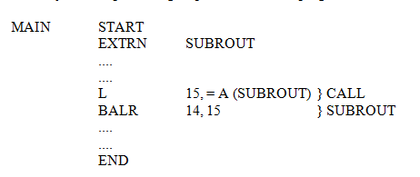
Subroutine Linkage
For example, the given sequence of instructions may be a simple calling sequence to another program

Slide 12
Subroutine Linkage
For example, the given sequence of instructions may be a simple calling sequence to another program
The above sequence of instructions first declares SUBROUT as an external variable, that is, a variable reference but not defined in this program.

Slide 13
Subroutine Linkage
For example, the given sequence of instructions may be a simple calling sequence to another program
The above sequence of instructions first declares SUBROUT as an external variable, that is, a variable reference but not defined in this program.
The load instruction loads the address of that variable into register 15.

Slide 14
Subroutine Linkage
For example, the given sequence of instructions may be a simple calling sequence to another program
The above sequence of instructions first declares SUBROUT as an external variable, that is, a variable reference but not defined in this program.
The load instruction loads the address of that variable into register 15.
The BALR instruction branches to the contents of register 15, which is the address of SUBROUT, and leaves the value of the next Instruction in register 14.

Slide 15
Subroutine Linkage
For example, the given sequence of instructions may be a simple calling sequence to another program
The above sequence of instructions first declares SUBROUT as an external variable, that is, a variable reference but not defined in this program.
The load instruction loads the address of that variable into register 15.
The BALR instruction branches to the contents of register 15, which is the address of SUBROUT, and leaves the value of the next Instruction in register 14.
In most assemblies, we may simply use a CALL SUBROUT macro, which is translated by the assembler into a calling sequence

Slide 16
Relocating loader

Slide 17
Relocating
Loader
Relocation:
The process of updating the addresses used in the address sensitive instruction of program

Slide 18
Relocating
Loader
Relocation:
The process of updating the addresses used in the address sensitive instruction of program
The object code is executed after loading at storage locations

Slide 19
Relocating
Loader
Relocation:
The process of updating the addresses used in the address sensitive instruction of program
The object code is executed after loading at storage locations
The addresses of such object code will be specified only after the assembly process is over.

Slide 20
Relocating
Loader
Relocation:
The process of updating the addresses used in the address sensitive instruction of program
The object code is executed after loading at storage locations
The addresses of such object code will be specified only after the assembly process is over.
Therefore, after loading,
Address of object code = Only Address of object code + Relocation constant

Slide 21
Relocating
Loader
Advantages:
To avoid possible reassembling of all subroutines when a single subroutine is changed
To perform the tasks of allocation and linking for the programmer

Slide 22
Relocating
Loader
Advantages:
To avoid possible reassembling of all subroutines when a single subroutine is changed
To perform the tasks of allocation and linking for the programmer
Tasks Performed:
Allocation
Relocation
Linking
Loading

Slide 23
Relocating
Loader
The BSS loader allows many procedure segments
Binary Symbolic Subroutine Loader (BSS)

Slide 24
Relocating
Loader
The BSS loader allows many procedure segments
It allows only one data segment (common segment)
Binary Symbolic Subroutine Loader (BSS)

Slide 25
Relocating
Loader
The BSS loader allows many procedure segments
It allows only one data segment (common segment)
The assembler assembles each procedure segment independently
Binary Symbolic Subroutine Loader (BSS)

Slide 26
Relocating
Loader
The BSS loader allows many procedure segments
It allows only one data segment (common segment)
The assembler assembles each procedure segment independently
Then it passes the text and information to the loader as relocation and intersegment references.
Binary Symbolic Subroutine Loader (BSS)

Slide 27
Binary Symbolic Subroutine Loader (BSS)
The output of a relocating assembler using a BSS scheme is the object program and information about all other programs it references.

Slide 28
Binary Symbolic Subroutine Loader (BSS)
The output of a relocating assembler using a BSS scheme is the object program and information about all other programs it references.
In addition, there is information (relocation information) for locations in this program that need to be changed if it is to be loaded in an arbitrary place in core, i.e . the locations which are dependent on the core allocation.

Slide 29
Binary Symbolic Subroutine Loader (BSS)
The output of a relocating assembler using a BSS scheme is the object program and information about all other programs it references.
In addition, there is information (relocation information) for locations in this program that need to be changed if it is to be loaded in an arbitrary place in core, i.e . the locations which are dependent on the core allocation.
For each source program the assembler outputs a text (machine translation of the program) prefixed by a transfer vector that consists of addresses containing names of the subroutines referenced by the source program

Slide 30
Binary Symbolic Subroutine Loader (BSS)
Process of Relocation:
For example, if a square Root Routine (SQRT) was referenced and was the first subroutine called,

Slide 31
Binary Symbolic Subroutine Loader (BSS)
Process of Relocation:
For example, if a square Root Routine (SQRT) was referenced and was the first subroutine called,
The first location in the transfer vector would contain the symbolic name SQRT.

Slide 32
Binary Symbolic Subroutine Loader (BSS)
Process of Relocation:
For example, if a square Root Routine (SQRT) was referenced and was the first subroutine called,
The first location in the transfer vector would contain the symbolic name SQRT.
The statement calling SQRT would be translated into a transfer instruction
  It indicates a branch to the location of the transfer vector associated with SQRT

Slide 33
Binary Symbolic Subroutine Loader (BSS)
Process of Relocation:
For example, if a square Root Routine (SQRT) was referenced and was the first subroutine called,
The first location in the transfer vector would contain the symbolic name SQRT.
The statement calling SQRT would be translated into a transfer instruction
  It indicates a branch to the location of the transfer vector associated with SQRT
The assembler would also provide the loader with additional information
  The length of the entire program
  The length of the transfer vector portion.

Slide 34
Binary Symbolic Subroutine Loader (BSS)
Process of Relocation:
For example, if a square Root Routine (SQRT) was referenced and was the first subroutine called,
The first location in the transfer vector would contain the symbolic name SQRT.
The statement calling SQRT would be translated into a transfer instruction
  It indicates a branch to the location of the transfer vector associated with SQRT
The assembler would also provide the loader with additional information
  The length of the entire program
  The length of the transfer vector portion.
After loading the text and the transfer vector into core, the loader would load each subroutine identified in the transfer vector.

Slide 35
Binary Symbolic Subroutine Loader (BSS)
Process of Relocation:
For example, if a square Root Routine (SQRT) was referenced and was the first subroutine called,
The first location in the transfer vector would contain the symbolic name SQRT.
The statement calling SQRT would be translated into a transfer instruction
  It indicates a branch to the location of the transfer vector associated with SQRT
The assembler would also provide the loader with additional information
  The length of the entire program
  The length of the transfer vector portion.
After loading the text and the transfer vector into core, the loader would load each subroutine identified in the transfer vector.
It would then place a transfer instruction to the corresponding subroutine in each entry in the transfer vector.

Slide 36
Binary Symbolic Subroutine Loader (BSS)
The execution of the call SQRT statement would result in
  a branch to the first location in the transfer vector,
  It would contain a transfer instruction to the location of SQRT.

Slide 37
Binary Symbolic Subroutine Loader (BSS)
The execution of the call SQRT statement would result in
  a branch to the first location in the transfer vector,
  It would contain a transfer instruction to the location of SQRT.
Problem:
  it is necessary to relocate the address portion of every instruction
  computers with a direct address instruction format have a much more severe relocation problem

Slide 38
Binary Symbolic Subroutine Loader (BSS)
The execution of the call SQRT statement would result in
  a branch to the first location in the transfer vector,
  It would contain a transfer instruction to the location of SQRT.
Problem:
  it is necessary to relocate the address portion of every instruction
  computers with a direct address instruction format have a much more severe relocation problem
Solution:
  The assembler associates a bit with each Instruction or address field.
  If this bit equals one, then the corresponding address field must be relocated otherwise the field is not relocated.
  These relocation indicators, are known as relocation bits and are included in the object deck.

Slide 39
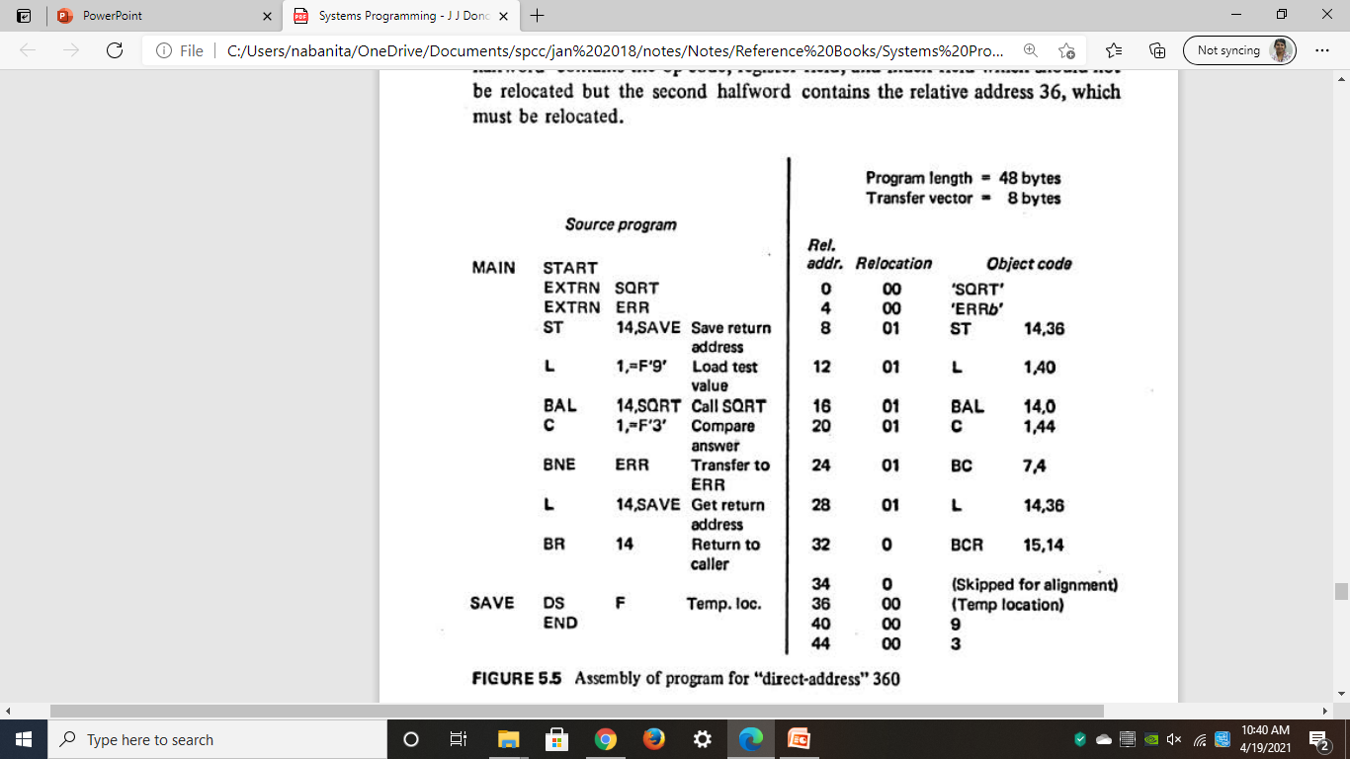
Binary Symbolic Subroutine Loader (BSS)
The figure illustrates a simple assembly language program written for a hypothetical "direct-address" 360 that uses a BSS loader.

Slide 40
Binary Symbolic Subroutine Loader (BSS)
The figure illustrates a simple assembly language program written for a hypothetical "direct-address" 360 that uses a BSS loader.
It supposedly calls the SQRT subroutine to get the square root of 9.

Slide 41
Binary Symbolic Subroutine Loader (BSS)
The figure illustrates a simple assembly language program written for a hypothetical "direct-address" 360 that uses a BSS loader.
It supposedly calls the SQRT subroutine to get the square root of 9.
If the result is not 3, it transfers to a subroutine called ERR.

Slide 42
Binary Symbolic Subroutine Loader (BSS)
The figure illustrates a simple assembly language program written for a hypothetical "direct-address" 360 that uses a BSS loader.
It supposedly calls the SQRT subroutine to get the square root of 9.
If the result is not 3, it transfers to a subroutine called ERR.
Since this is a direct-address computer, there is no base register field in the object code and no need for a USING pseudo-op in the source program.

Slide 43
Binary Symbolic Subroutine Loader (BSS)
The EXTRN pseudo op identifies the symbols SQRT and ERR as the names of other subroutines

Slide 44
Binary Symbolic Subroutine Loader (BSS)
The EXTRN pseudo op identifies the symbols SQRT and ERR as the names of other subroutines
Since the locations of these symbols are not defined in this subroutine, they are called external symbols.

Slide 45
Binary Symbolic Subroutine Loader (BSS)
The EXTRN pseudo op identifies the symbols SQRT and ERR as the names of other subroutines
Since the locations of these symbols are not defined in this subroutine, they are called external symbols.
For each external symbol the assembler generates a four byte fullword at the beginning of the program, containing the EBCDIC characters for the symbol

Slide 46
Binary Symbolic Subroutine Loader (BSS)
The EXTRN pseudo op identifies the symbols SQRT and ERR as the names of other subroutines
Since the locations of these symbols are not defined in this subroutine, they are called external symbols.
For each external symbol the assembler generates a four byte fullword at the beginning of the program, containing the EBCDIC characters for the symbol
These extra words are called transfer vectors.

Slide 47
Binary Symbolic Subroutine Loader (BSS)
Every reference to an external symbol is assigned the address of the corresponding transfer vector word

Slide 48
Binary Symbolic Subroutine Loader (BSS)
Every reference to an external symbol is assigned the address of the corresponding transfer vector word
In addition, for every halfword (two bytes) in the program, the assembler produces a separate relocation bit.

Slide 49
Binary Symbolic Subroutine Loader (BSS)
Every reference to an external symbol is assigned the address of the corresponding transfer vector word
In addition, for every halfword (two bytes) in the program, the assembler produces a separate relocation bit.
For example,
The assembled instruction ST 14,36 is assigned relocation bits 01 since the first halfword contains the op-code, register field, and index field which should not be relocated
but the second halfword contains the relative address 36, which must be relocated.

Slide 50
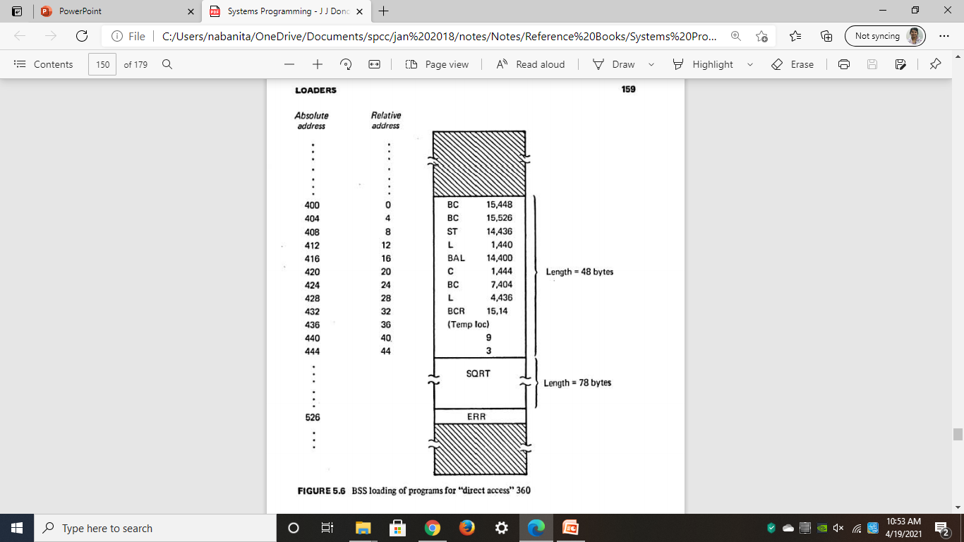
Binary Symbolic Subroutine Loader (BSS)
The figure illustrates the contents of memory after the programs have been loaded by the BSS loader.

Slide 51
Binary Symbolic Subroutine Loader (BSS)
The figure illustrates the contents of memory after the programs have been loaded by the BSS loader.
Based upon the relocation bits, the loader has relocated the address fields to correspond to the allocated address of MAIN which is 400.

Slide 52
Binary Symbolic Subroutine Loader (BSS)
The figure illustrates the contents of memory after the programs have been loaded by the BSS loader.
Based upon the relocation bits, the loader has relocated the address fields to correspond to the allocated address of MAIN which is 400.
Using the program length information, the loader placed the sub routines SQRT and ERR at the next available locations which were 448 and 526, respectively

Slide 53
Binary Symbolic Subroutine Loader (BSS)
The figure illustrates the contents of memory after the programs have been loaded by the BSS loader.
Based upon the relocation bits, the loader has relocated the address fields to correspond to the allocated address of MAIN which is 400.
Using the program length information, the loader placed the sub routines SQRT and ERR at the next available locations which were 448 and 526, respectively
Finally, the transfer vector words were changed to contain branch instructions to the corresponding subroutines

Slide 54
Binary Symbolic Subroutine Loader (BSS)
Thus, the four functions of the loader (allocation, linking, relocation, and loading) were all performed automatically by the BSS loader.

Slide 55
Binary Symbolic Subroutine Loader (BSS)
Disadvantages:
The transfer vector linkage is only useful for transfers, and is not well-suited for loading or storing external data (data located in another procedure segment).
The transfer vector increases the size of the object program in memory.
The BSS loader, processes procedure segments but does not facilitate access to data segments that can be shared.

Slide 56
Dynamic Loading
If the total amount of core required by all the subroutines exceeds the amount available, then it is problem
There are several hardware techniques, such as paging and segmentation, that attempt to solve this problem;
For loaders: A scheme is applied which uses Binders

Slide 57
Loading
Process
A binder is a program that performs the same functions as the direct-linking loader in "binding" subroutines together, but rather than placing the relocated and linked text directly into memory, it outputs the text as a file or card deck.
This output file is in a format ready to be loaded and is typically called a load module.
Binder: Allocation, Relocation, Linking
The module loader has to physically load the module into core.
Module Loader: Task of Loading

Slide 58
Dynamic Loading
In each of the previous loader schemes we have assumed that all of the subroutines needed are loaded into core at the same time.

Slide 59
Dynamic Loading
In each of the previous loader schemes we have assumed that all of the subroutines needed are loaded into core at the same time.
If the total amount of core required by all these subroutines exceeds the amount available, then it is a problem

Slide 60
Dynamic Loading
In each of the previous loader schemes we have assumed that all of the subroutines needed are loaded into core at the same time.
If the total amount of core required by all these subroutines exceeds the amount available, then it is a problem
There are several hardware techniques, such as paging and segmentation, that attempt to solve this problem

Slide 61
Dynamic Loading
In each of the previous loader schemes we have assumed that all of the subroutines needed are loaded into core at the same time.
If the total amount of core required by all these subroutines exceeds the amount available, then it is a problem
There are several hardware techniques, such as paging and segmentation, that attempt to solve this problem
A dynamic loading schemes based upon the concept of a binder prior to loading can solve this problem

Slide 62
Dynamic Loading
In each of the previous loader schemes we have assumed that all of the subroutines needed are loaded into core at the same time.
If the total amount of core required by all these subroutines exceeds the amount available, then it is a problem
There are several hardware techniques, such as paging and segmentation, that attempt to solve this problem
A dynamic loading schemes based upon the concept of a binder prior to loading can solve this problem
Usually the subroutines of a program are needed at different times

Slide 63
Dynamic Loading
By explicitly recognizing which subroutines call other subroutines it is possible to produce an overlay structure that identifies mutually exclusive subroutines.

Slide 64
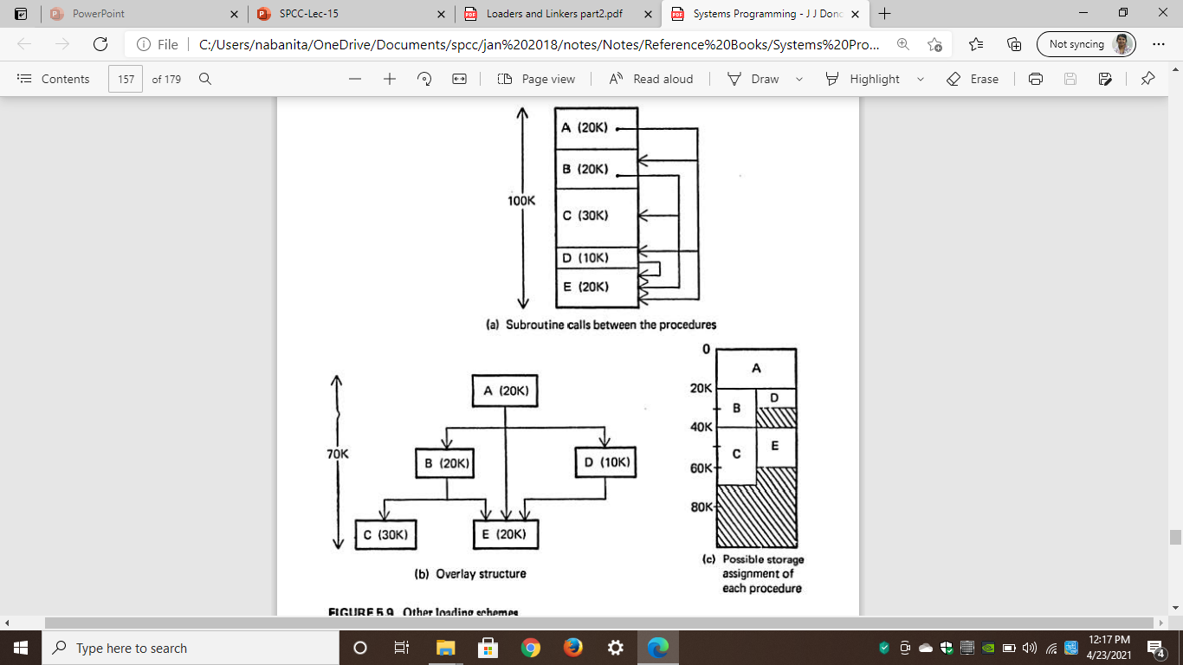
Dynamic Loading
In the figure(a): A program consisting of five subprograms (A,B,C,D and E) that require lOO K bytes of core.
The arrows indicate that subprogram A only calls B, D and E
Subprogram B only calls C and E; subprogram D only calls E;
Subprograms C and E do not call any other routines.

Slide 65
Dynamic Loading
In Figure 5 .9b the inter-depencencies between the procedures are highlighted
Procedures B and D arc never in use at the same time; neither are C and E.
If we load only those procedures that are actually to be used at any particular time, the amount of core needed is equal to the longest path of the overlay structure.
This happens to be 70K for the example in Figure 5.9b - procedures A, B, and C.
Figure 5.9c illustrates a storage assignment for each procedure consistent with the overlay structure.

Slide 66
Dynamic Loading
In Figure 5 .9b the inter-depencencies between the procedures are highlighted
Procedures B and D arc never in use at the same time; neither are C and E.
If we load only those procedures that are actually to be used at any particular time, the amount of core needed is equal to the longest path of the overlay structure.
This happens to be 70K for the example in Figure 5.9b - procedures A, B, and C.
Figure 5.9c illustrates a storage assignment for each procedure consistent with the overlay structure.

Slide 67
Overlay Structure
In order for the overlay structure to work it is necessary for the module loader to load the various procedures as they are needed.

Slide 68
Overlay Structure
In order for the overlay structure to work it is necessary for the module loader to load the various procedures as they are needed.
There are many binders capable of processing and allocating an overlay structure.

Slide 69
Overlay Structure
In order for the overlay structure to work it is necessary for the module loader to load the various procedures as they are needed.
There are many binders capable of processing and allocating an overlay structure.
The portion of the loader that actually intercepts the "calls" and loads the necessary procedure is called the overlay supervisor or simply the flipper.

Slide 70
Overlay Structure
In order for the overlay structure to work it is necessary for the module loader to load the various procedures as they are needed.
There are many binders capable of processing and allocating an overlay structure.
The portion of the loader that actually intercepts the "calls" and loads the necessary procedure is called the overlay supervisor or simply the flipper.
This overall scheme is called dynamic loading or load-on-call (LOCAL).

Slide 71
Overlay Structure
Disadvantage
If a subroutine is referenced but never executed, the loader would still incur the overhead of linking the subroutine.
Furthermore, all of these schemes require the programmer to explicitly name all procedures that might be called.

Slide 72
Dynamic Linking
This is a mechanism by which loading and linking of external references are postponed until execution time.

Slide 73
Dynamic Linking
This is a mechanism by which loading and linking of external references are postponed until execution time.
The assembler produces text, binding, and relocation information from a source language deck.

Slide 74
Dynamic Linking
This is a mechanism by which loading and linking of external references are postponed until execution time.
The assembler produces text, binding, and relocation information from a source language deck.
The loader loads only the main program.

Slide 75
Dynamic Linking
This is a mechanism by which loading and linking of external references are postponed until execution time.
The assembler produces text, binding, and relocation information from a source language deck.
The loader loads only the main program.
If the main program should execute a transfer instruction to an external address, or should reference an external variable, then the loader is called.

Slide 76
Dynamic Linking
This is a mechanism by which loading and linking of external references are postponed until execution time.
The assembler produces text, binding, and relocation information from a source language deck.
The loader loads only the main program.
If the main program should execute a transfer instruction to an external address, or should reference an external variable, then the loader is called.
Only then is the segment containing the external reference is loaded.

Slide 77
Dynamic Linking
Advantage:
No overhead is incurred unless the procedure to be called or referenced is actually used.
The system can be dynamically reconfigured.

Slide 78
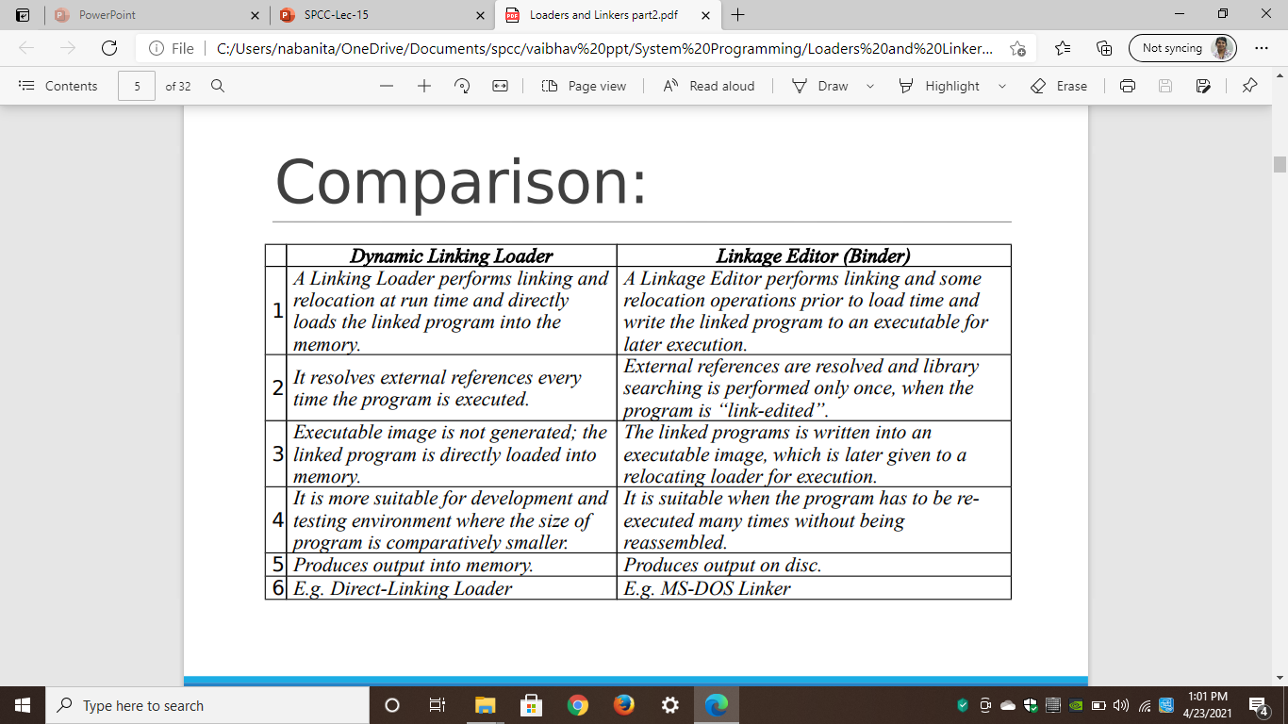
Dynamic linking vs binders

